Slide 1
Compounds Containing
A Carbonyl Group
Dr.Entssar

Slide 2
Learning objectives
1-Define carbonyl group
2- Classification of carbonyl compounds
3-Naming of aldehyde and ketones
4-preparation of aldehyde and ketone
5-Reaction of aldehyde and ketone

Slide 3

Carbonyl Group
Carbonyl Group
Carbonyl group: is afunctional group composed of carbon atom double-bonded to an oxygen atom (C=O).
It is common to several classes of organic compounds, as part of many larger functional groups .A compound containing a carbonyl group is often referred to as a carbonyl compound

Slide 4
A carbon– oxygen double bond is polar, and a carbon–carbon double bond is nonpolar.
Because of a difference in the electron affinities of the carbon and
oxygen atoms, the electron pairs that constitute the double bond are
held closer to the oxygen atom than to the carbon atom; the electron rich oxygen atom acquires a negative charge and the electron-deficient
carbon atom a positive charge.
Compounds containing a carbonyl group have higher melting and boiling points than hydrocarbons containing the same number of carbon atoms and are more soluble in polar solvents such as water.

Slide 5
Comparing Physical Properties
Boiling Point: Water Solubility
Carboxylic acid Carboxylic acid
Alcohols Alcohol
Aldehydes/Ketones Aldehydes/Ketones
Ethers Ethers
Alkanes Alkanes

Slide 6
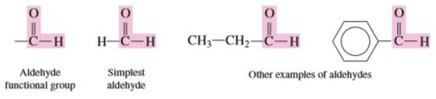
Classification of carbonyl compounds
1. Aldehydes.
An aldehyde is a carbonyl-containing organic compound in which the carbonyl carbon atom has at least one hydrogen atom directly
attached to it. The remaining group attached to the carbonyl carbon atom can be hydrogen, an alkyl group (R), a cycloalkyl group, or an aryl group (Ar).

Slide 7
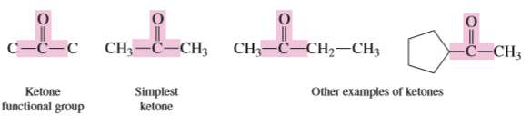
2. Ketones.
A ketone is a carbonyl containing organic compound in which the carbonyl carbon atom has two other carbon atoms directly attached to it.
The groups containing these bonded carbon atoms may be alkyl, cycloalkyl, or aryl

Slide 8
3. Carboxylic acids.
Organic compounds which contain the carboxyl functional group are called as carboxylic acids.
The name carboxyl is derived from carbonyl (C=O)and hydroxyl(OH)because in the carboxyl group these two groups are directly bonded to each other.
The structural parameters for a carboxylic acid are the same as those for an aldehyde except that the hydroxyl group replaces the hydrogen atom of an aldehyde

Slide 9
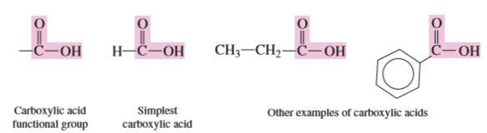

Slide 10
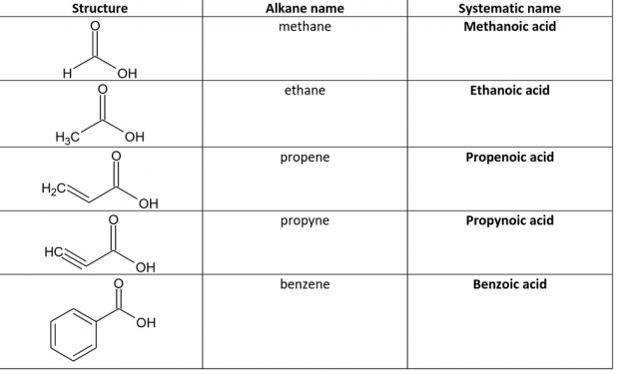

Slide 11
4. Esters.
Is a chemical compound derive from an acid in which at least one (OH)hydroxyl group is replaced by an (-O-alkyl)alkoxyl group.

Slide 12
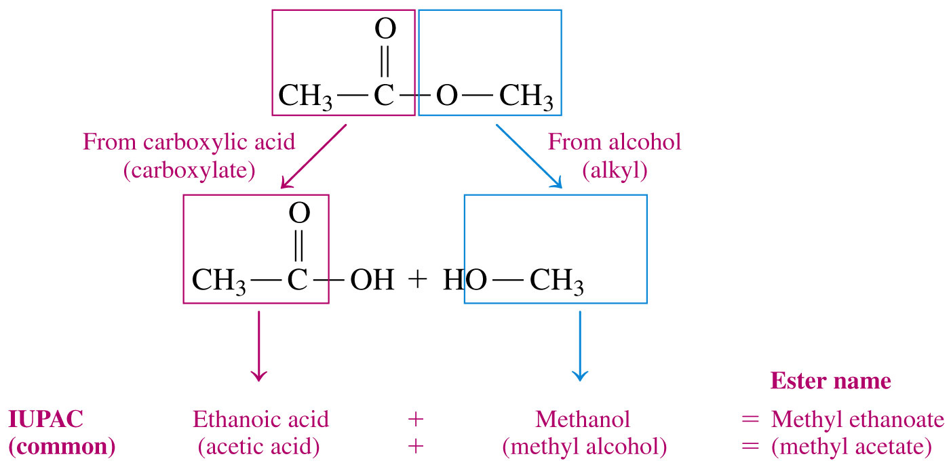
Naming Esters

Slide 13
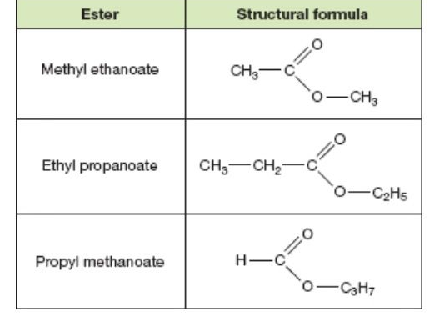

Slide 15
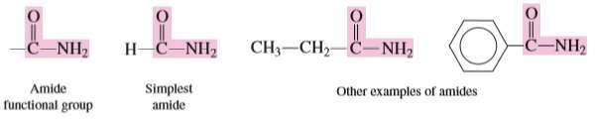
5. Amides.
The previous four types of carbonyl compounds contain the elements
carbon, hydrogen, and oxygen. Amides are different from these compounds in that the element nitrogen, in addition to carbon,
hydrogen, and oxygen, is present.
In an amide, an amino group (—NH2) or substituted amino group replaces the —OH group of a carboxylic acid.

Slide 16
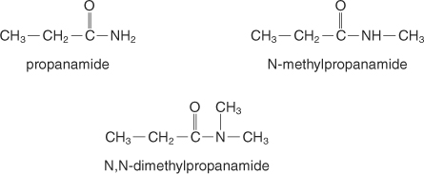
An amide name is based on the name of the carboxylic acid of the same number of carbon atoms, but the ‐oic ending is changed to amide. Amides with alkyl groups on the nitrogen are substituted amides and are named the same as N‐substituted amides, except the parent name is preceded by the name of the alkyl substituent and a capital N precedes the substituent name.

Slide 17
Names for Ketones
The rules are analogous to the rules for aldehydes. The –e ending of the parent alkane is changed to –one.
The location of the carbonyl is indicated with a number. [This number is never 1- because that would be an aldehyde!]
The longest carbon chain is numbered to give the carbonyl the lowest possible number.

Slide 18
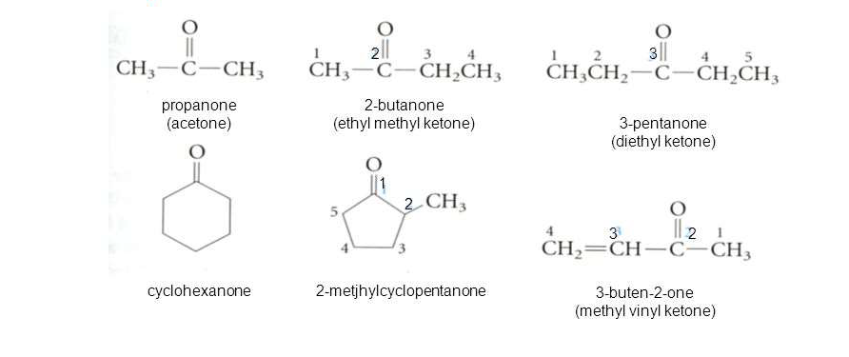

Slide 19
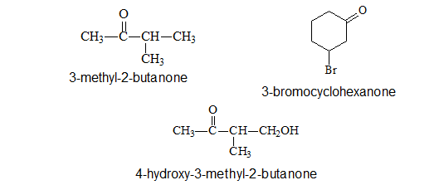

Slide 20
Naming Aldehydes
The parent compound is named for the longest continuous chain containing the carbonyl group.
The final –e of the parent alkane is replaced with –al. The chain is numbered beginning at the carbonyl carbon.
Substituents are named and numbered as usual.
The aldehyde is always carbon 1, so no number is used for the
carbonyl group.

Slide 21
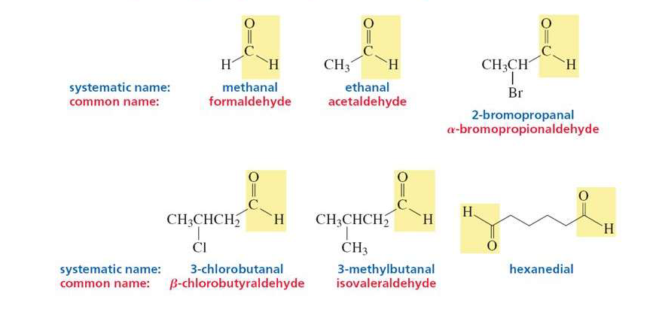

Slide 22
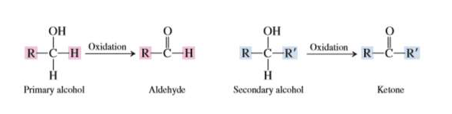
Preparation of Aldehydes and
Ketones
Aldeheydes and ketones can be produced by the oxidation of
primary and secondary alcohols, respectively, using mild oxidizing
agents such as KMnO4 or K2

Slide 23
Aldehydes readily undergo oxidation to carboxylic acids, and ketones are resistant to oxidation.

Slide 24
Distinguish between aldehydes and ketones
Tollen’s test :is used to distinguish between aldehydes and ketones based on their ability to be oxidized.
involves a solution that contains silver nitrate (AgNO3) and ammonia (NH3) in water. When Tollens solution is added to an aldehyde, Ag+ ion
(the oxidizing agent) is reduced to silver metal, which deposits on the inside of the test tube, forming a silver mirror. The appearance of this
silver mirror is a positive test for the presence of the aldehyde group.
The Ag+ ion will not oxidize ketones.

Slide 25
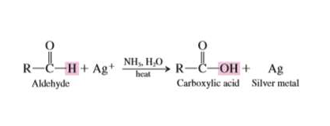

Slide 26
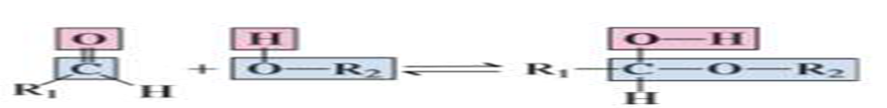
Reaction of aldehyde and ketones with alcohol
Aldehydes and ketones react with alcohols to form hemiacetals and acetals.
Hemiacetal is an organic compound in which a carbon atom is bonded
to both a hydroxyl group (OH) and an alkoxy group(OR).
Aldehyde an alcohol a hemiacetal

Slide 27
Ketone reaction with alcohol formation hemiketal
Ketone alcohol hemiketal

Slide 28
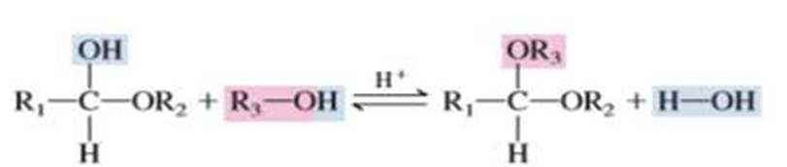
Acetal Formation
Acetals are organic compounds having the structure R₂C(OR’)₂ (R’ ≠ H). They are organic compounds formed by addition of alcohol molecules to aldehyde or ketone molecules. Originally, the term was confined to derivatives of aldehydes (one R = H), but it now applies equally to derivatives of ketones (neither R = H ). Mixed acetals have different R’ groups. The formation of acetals is reversible; acetals can be hydrolysed back to aldehydes (ketone) in acidic solutions.
Hemiacetal alcohol acetal

